Slide 1
Section 1.2
Limits of Sequences

Slide 2
Area of a Circle
Do you ever remember how to obtain the area of a circle?
……
…………… The area of a polygon
with
The area of a hexagon
The area of a dodecagon
……………………………….
sides

Slide 3

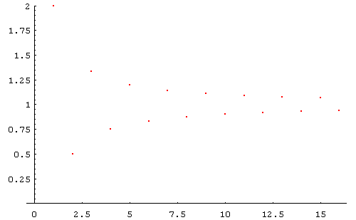
Limit of a Sequence
Observe the changing of a sequence while

Slide 4
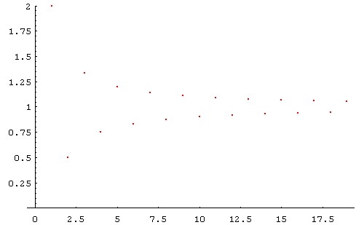
Limit of a Sequence
Observe the changing of a sequence while

Slide 5
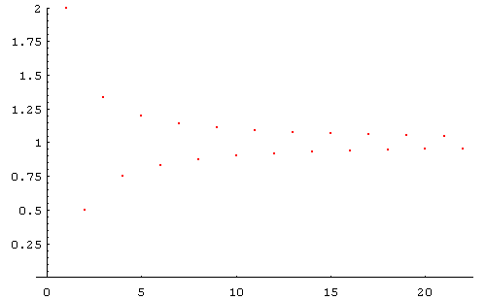
Limit of a Sequence
Observe the changing of a sequence while

Slide 6
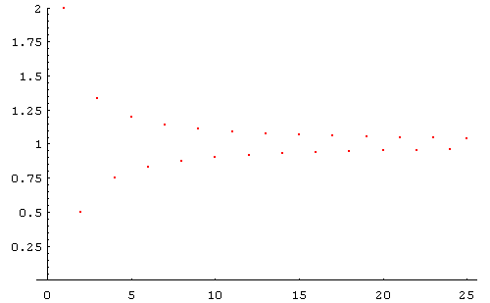
Limit of a Sequence
Observe the changing of a sequence while

Slide 7
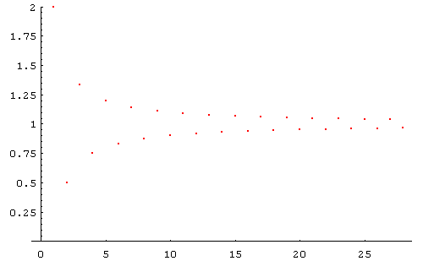
Limit of a Sequence
Observe the changing of a sequence while

Slide 8
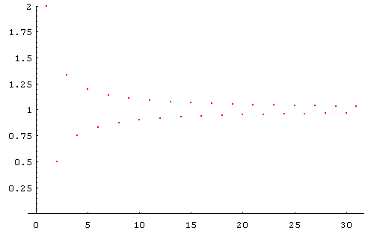
Limit of a Sequence
Observe the changing of a sequence while

Slide 9
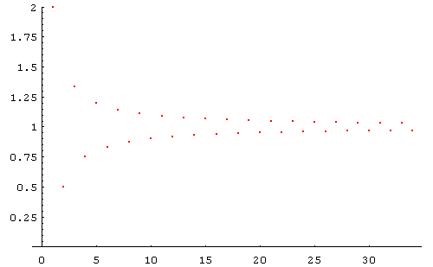
Limit of a Sequence
Observe the changing of a sequence while

Slide 10
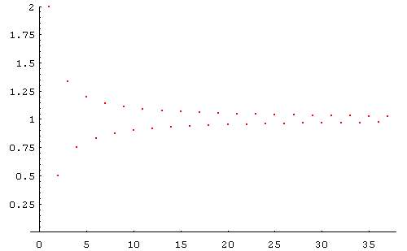
Limit of a Sequence
Observe the changing of a sequence while

Slide 11
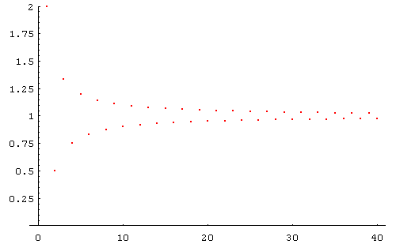
Limit of a Sequence
Observe the changing of a sequence while

Slide 12
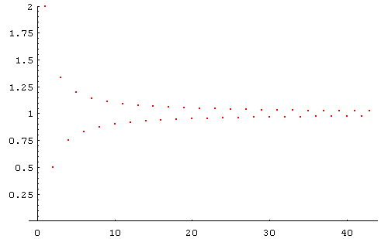
Limit of a Sequence
Observe the changing of a sequence while

Slide 13
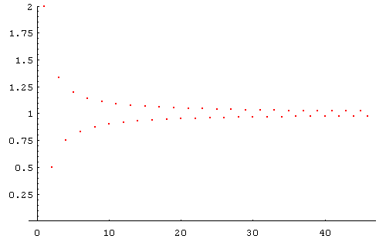
Limit of a Sequence
Observe the changing of a sequence while

Slide 14
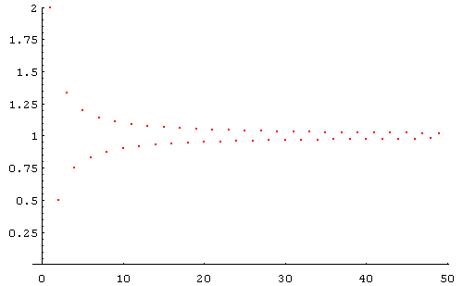
Limit of a Sequence
Observe the changing of a sequence while

Slide 15
Sequence of Numbers
Definition A sequence of numbers [数列] is just a special
function f ,defined on the set
denoted by
where
,
, is called the general term [通项]
of the sequence.
Example

Slide 16
Limit of a Sequence
While n tends to infinity,
The limits are 0
Approach to zero [趋于零]
Does not
approach
any value
No limits
Approaches
infinity [无穷]

Slide 17
Concept of Limit of a Sequence
Definition (Limit of a sequence of numbers)
The sequence
converges [收敛] to the number A if and
only if to every positive number ε there exists a positive integer N such that
holds for all
Then we say that the sequence
approaches to A as n tends
to infinity, denoted by
or
And A is called the limit [ 极限] of the sequence
If there is no such number A, we say that {a_{n}} diverges [发散].

Slide 18
Concept of Limit of a Sequence
Another expression of the definition of limit for a sequence is:
s. t.
for all
Note The definition can be used to judge whether A is the limit of {a_{n}}, but is not an efficient method used to find the limit or judge whether the limit exists.

Slide 19
Concept of Limit of a Sequence
Geometric explanation of the definition
Notice that
means that
We call the open interval
-neighborhood of A
Let us draw the sequence {a_{n}} on an axis to demonstrate the definition of limit by geometric graph
Question: Is
out of the neighborhood
for all n<=N?

Slide 20
Concept of limit of a sequence
s. t.
for all
The definition of limit is an important tool used to judge if a constant is the limit of a sequence.
Example
Prove that
Proof For any given
we want to find a N, s. t.
, for all
Since
we only need to find a N, s. t.
or
for all
It is enough to choose
So we have found a N, s. t.
, for all
Hence,
. This is the end.

Slide 21
Concept of Limit of a Sequence
Note N is a subscript in the sequence, which acts like a boundary
to ensure
after n>N. Generally, N is depend on
and
and denoted by
. Also, N is not unique.
is positive, and can be chosen arbitrarily small, but it is a constant whenever it is given.
Note
Note is used to describe the fact that the distance | a_{n} - A | may be arbitrarily small.
Also, we can use

Slide 22
Concept of Limit of a Sequence
Note The requirement that
is for all n>N,
not only for an infinite number of n.
For example, the sequence
does not approach a constant.
Note The expression of the sequence
does not tend to A
as
n tends to infinity is:
,

Slide 23
Concept of Limit of a Sequence
Example
Prove that
where
Proof
there is no harm in assuming that
We want to find a
such that
Notice that ln| q |<0, so the requirement is
So,
we choose
Then, for all
we have
This means

Slide 24
Concept of Limit of a Sequence
If
and
, prove
Example
and
Proof Since
, we have
,
, such that
, for all n>N,
that is
. Since
and
, we have
. Noticing that
, we have
.
Moreover, we have
. That is
.
So, we have
.
Similarly, we can prove
.
Finish.

Slide 25
Properties of Limit of a Sequence
Theorem (Uniqueness)
The limit of any convergent sequence is unique.
Proof
Assume that the sequence has two different limits
and
that is
and
,
.
Let’s suppose
(If
, we have the same conclusion) and choose a positive
. Since
, by the definition of limit, for any given
, there exists
a
, such that
for all
. It means that
.
Similarly, since
, we have
( )
( )
B
A
x
for some N₂ and for all n> N₂.
This is impossible. The proof is completed.

Slide 26
Properties of Limit of a Sequence
Theorem (Preservation of sign)

Slide 27
Properties of Limit of a Sequence
Theorem (Isotone)

Slide 28
Conditions for Convergence of A Sequence
Definition (boundedness of a sequence)
Let
be a sequence.
If there exists a constant
(independent of
)
such that
holds for all
. Then,
is said to be bounded.
Otherwise,
is said to be unbounded.
Moreover, if
(or
)
for all
,
is said to be bounded above (or below).
bounded:
unbounded:
Bounded below
Unbounded
Bounded
Bounded above

Slide 29
Conditions for Convergence of a Sequence
Theorem (boundedness)
Any convergent sequence must be bounded.
Proof
Suppose that
is a sequence and
By the definition of limit,
for given
, there exists a
, such that
holds for all
Thus, when
, we have
or
.

Slide 30
Conditions for convergence of a sequence
Theorem (boundedness)
Any convergent sequence must be bounded.
Proof (continued)
.
There are at most
points,
outside the interval
.
Since there are finite terms,
it is obvious
that we can find a number B,
s. t.
.
If we choose
, then
is bounded.
This is the end.

Slide 31
Conditions for convergence of a sequence
Definition (monotonicity of a sequence)
Let
be a sequence.
If for every subscript
, we always have
,
then
is called to be monotone increasing;
if we always have
,
then
is called to be monotone decreasing.
A sequence which is
either monotone increasing or monotone decreasing is called monotone.
Monotone increasing
Monotone decreasing

Slide 32
Conditions for convergence of a sequence
Theorem (monotone boundedness criterion) If a sequence is monotone increasing and bounded above or monotone decreasing and bounded below, then it must be convergent.
Monotone increasing and bounded above [单调递增有上界]
Monotone decreasing and bounded below [单调递减有下界]

Slide 33
Conditions for convergence of a sequence
Note It is clear that changing any finite number of terms of a sequence does not affect its convergence and limit.
For instance, let
If we change the first 2n numbers of this sequence to 1 and keep the others unchanged. We have
.
.
.
We had known that this sequence does
not have limit or does not convergent.
It is clear that this sequence still does not
have limit or does not convergent.

Slide 34
Conditions for convergence of a sequence
But if we change terms with subscript as
to
,
then the new sequence becomes convergent or has limit.
.
By the theorem of monotone boundedness criterion, this new sequence is convergent

Slide 35
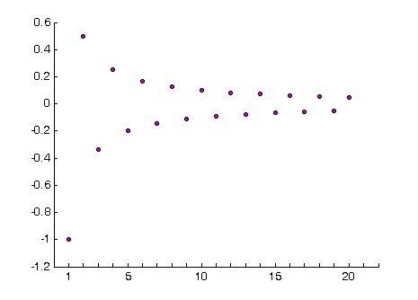
Conditions for convergence of a sequence
Note If a sequence is bounded but monotone only starting form term, then it is still convergent.
Note It should be recognized that the theorem is only a sufficient condition for convergence. A convergent sequence is not necessarily monotone.
For instance, let
{a_{n}} is a convergent
but is not monotone.

Slide 36
Conditions for convergence of a sequence
Example Let
and
, prove that
exists.
Proof Since
and
, by mathematical induction method, we have
for all n.
That is the sequence
is monotone
increasing.
Moreover, it is clear that
for all n.
Then, by monotone boundedness criterion, we can finish the proof.

Slide 37
Conditions for convergence of a sequence
Example (number
e) Prove that sequence
is convergent.

Slide 38



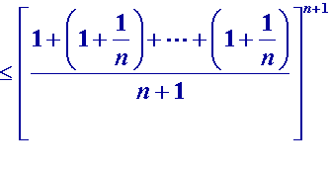


Conditions for convergence of a sequence
Example (number
e) Prove that sequence
is convergent.
Proof Let
, then
Therefore, for any
,we have
. So,
is monotone increasing.
If we can prove
is bounded above, then we will finish the proof.

Slide 39
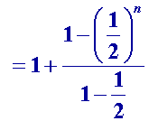


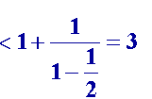


Conditions for convergence of a sequence
Example (number
e) Prove that sequence
is convergent.
Proof (continued)
Actually, term
can be expended as
Then
is bounded above. Finish.

Slide 40
Conditions for convergence of a sequence
Example (number
e) Prove that sequence
is convergent.
Remark This example shows that sequence
has limit and
this limit is denoted by
. That is
e
.
It can be proved that
is an irrational number
and

Slide 41
Conditions for convergence of a sequence
Theorem (Cauchy’s convergence principle) The necessary and sufficient condition for a sequence to be convergent is that
,
, such that
.
Remark
This theorem means that while
is sufficient large,
all the terms will
accumulate in an arbitrarily small neighborhood of some point.
Conversely,
if the distance between two points
and
is arbitrarily small for any
and
, then all terms will accumulate in an arbitrarily small
neighborhood of some point when
is large enough
and the sequence
converges to this point.

Slide 42





Conditions for Convergence of a Sequence
convergence
,
, s. t.
.
Example Prove that the sequence
is convergent, where
.
Proof We will use Cauchy’s theorem.
In fact, taking any
and
is equivalent to taking any
,
and considering
and
. Then
.

Slide 43
Conditions for convergence of a sequence
convergence
,
, s. t.
.
Example Prove that the sequence
is convergent, where
.
Proof (continued)
, we want to judge whether there exists a
, s. t.
.
Since
, then we can choose
.
Hence,
, there exists
, such that
for all
.
Finish.

Slide 44




Conditions for convergence of a sequence
Example
Prove that the sequence
is divergent, where
.
Proof
,
, s. t.
convergence
.
We only need to show that the condition of Cauchy’s theorem can not be hold.
That is,
,
,
, such that
We now take
,
. Since
Finish.

Slide 45
Conditions for convergence of a sequence

Slide 46
Conditions for convergence of a sequence
Example Determine whether the sequence
converges or diverges.
Solution
Taking n=4k, we get a subsequence
,
which converges to 0.
Taking n=8k+2, we get a subsequence
which converges to 1.
According to the aggregation principle, the sequence
is divergent.

Slide 47
Calculating Limits of Sequences
Theorem (Rules of rational operations)
Assume that
and
, then
(1)
(2)
(3)
, if
.

Slide 48



Calculating Limits of Sequences
Example Let
and
, find
.
Solution
We had proven that sequence
has limit
and we know that
if a sequence has limit, then the limit must unique.
We can suppose the limit is
, which will be solved later.
That is
.
Since
we have
,
.
That is
,
then we have
.
So,
(the negative value should be
omitted).
Finish.

Slide 49
Calculating Limits of Sequences
Note
The rules (1) and (2) rational operations theorem may be extended to any
finite number of sequence
if the limit of each one exists,
but they are not necessarily
true for an infinite number of sequences.
let
×
Example
?.
Solution
Corollary
If
is a constant and
,
then
(1)
,
(2)
,
.

Slide 50








Calculating Limits of Sequences
Example Find
Solution Since
,

Slide 51

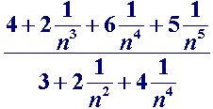
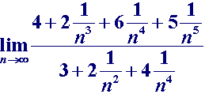


Calculating Limits of Sequences
Example Find
Solution
If we divide numerator and denominator by
,
we obtain
Using rules of rational operations theorem and it’s corollary we have

Slide 52






Calculating Limits of Sequences
Example Find
Solution Since
,
we have

Slide 53
Sandwich Theorem
Theorem (Sandwich Theorem [夹逼准则])
If
, such that
holds for all
and
then the sequence
is also convergent
and
.

Slide 54



Sandwich Theorem
? using the sandwich theorem
Example Find
, where
Solution:
Since
and
,
by the Sandwich theorem we known

Slide 55






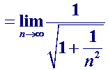


Sandwich Theorem
Example Find
Solution
Since
and
,
.
Then, by the Sandwich theorem we known

Slide 56
Sandwich Theorem
Example Find
where a > 0 is a constant.
Solution
When a =1,
it is easy to obtain
When a >1, let
By the binomial formula,
we have
So that
Please prove that
and
Then by the Sandwich theorem we known
When 0< a <1, then
so that
Hence

Slide 57
Review
Concept of limit of a sequence
a_{n} A:
uniqueness
Conditions for convergence of a sequence
Monotone boundedness criterion
Cauchy’s convergence principle
Rules of operations on convergent sequences
Rules of rational operations
Sandwich theorem
,
, s. t.
for all
.

